Slide 1

WITNEY OXFORD TRANSPORT GROUP’S CONSULTATION WITH WEST OXFORDSHIRE RESIDENTS
February – March 2021

Slide 2
ABOUT THE METHODOLOGY
The Witney Oxford Transport Group conducted a survey via surveymonkey to understand the level of support for a feasibility study to connect the communities of Carterton, Witney and Eynsham with Oxford. Key information about the study includes:
The study was conducted between Monday 22nd February 2021 and Thursday 4th March 2021.
671 respondents took part in the survey.
The survey was publicised via the Witney Gazette, Oxford Mail, Witney Radio and social media.
Respondents throughout the district of West Oxfordshire were represented in the sample (see page 16).
The survey was kept intentionally short to encourage participation and achieve a large sample size.
After the initial two questions regarding the rail line, 525 respondents agreed to answer a few additional questions about their local community.
The following slides outline the key findings from the study.

Slide 3
There is Overwhelming support for a feasibility study
97%
in support
Q. Do you support exploring the potential of restoring a railway line that connects the communities of Carterton, Witney and Eynsham with Oxford?
There is near universal support for exploring the possibility of a trainline connecting the communities of Carterton, Witney and Eynsham with Oxford.
Base: n=671
Notes:
Universal support from those not working but looking for work, disabled and under 17 year olds and those who do not identify as either female or male (all groups very small samples) but interesting all the same.

Slide 4
Plus NEAR UNANIMOUS LIKELIHOOD (94%) to use the new SERVICE
Three quarters (75%) of those surveyed state they are ‘very likely’ to use the new rail link. A further 12% state they are ‘likely’ and 7% ‘somewhat likely’.
‘Very likely’ to use is even higher amongst those employed: 78%, those aged under 30: 87%, and those who state they are ‘disabled, unable to work’: 100%*.
Q. If there was a new rail link that connected Carterton-Oxford in 22 minutes, Witney-Oxford in 16 minutes and Eynsham-Oxford in 9 minutes, how likely would you be to use the railway?
Base: n=671
*N.B. small base size, only 4 respondents stated for the employment question they were Disabled, unable to work.
Notes:
Disabled and those looking for work most likely to state they are very likely to use the railway.

Slide 5
Fast and accessible PUBLIC TRANSPORT IS THE NUMBER ONE ISSUE
Q. Thinking about local issues, please rank the following in order of importance to you…
% Ranking the issue as the most important issue to them
43%
rank ‘fast and accessible public transport’ as the most important of seven issues evaluated, significantly higher than any other issue.
84%
rank this issue in their top three most important issues.
Base: n=524
*Full code stated: Improvements to local facilities e.g. playgrounds, libraries, community centres
Notes:
Universal support from those not working but looking for work, disabled and under 17 year olds and those who do not identify as either female or male (all groups very small samples) but interesting all the same.

Slide 6
Traffic issues dominate the most important issues affecting the local community
When asked what are the most important issues affecting their local community (outside of the global pandemic) concerns around traffic congestion, transport links and lack of sufficient infrastructure are frequently mentioned by West Oxfordshire residents.
Of the 433 responses provided to this question 52% mentioned an aspect related to transport.
Notes:
Universal support from those not working but looking for work, disabled and under 17 year olds and those who do not identify as either female or male (all groups very small samples) but interesting all the same.

Slide 7
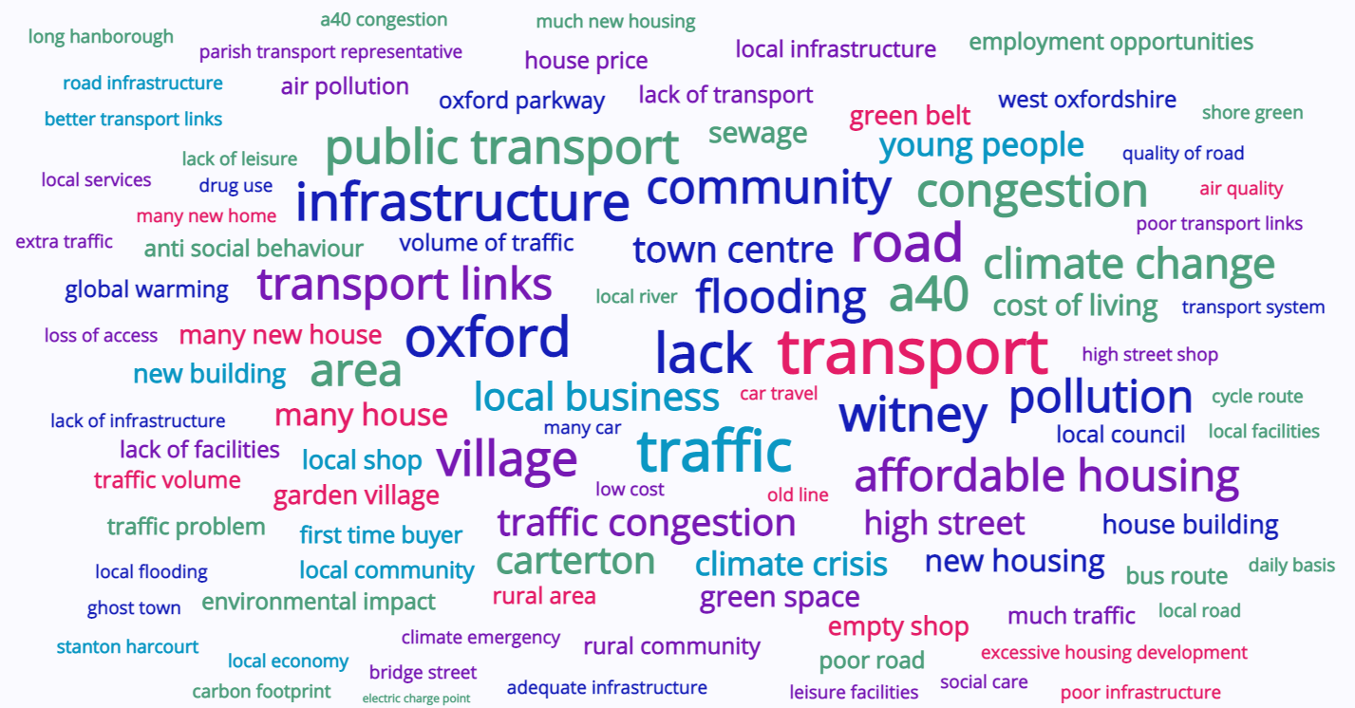
A Word cloud of the most frequently mentioned PHRASEs uncover numerous transport concerns
Q. Excluding the global pandemic, what for you is the most important issue affecting your local community?
N.B. The larger the font the more frequently the words were mentioned.
Notes:
Universal support from those not working but looking for work, disabled and under 17 year olds and those who do not identify as either female or male (all groups very small samples) but interesting all the same.

Slide 8
There are a number of traffic related concerns affecting the local community
In the pages that follow are some examples of the feedback provided around transport issues. Concerns raised by respondents have been grouped into key themes, including:
Concerns around the lack of infrastructure to support continued planning development in the region.
A desire to reduce the district’s carbon footprint and provide more sustainable transport options.
The negative impact existing transport options are having on productivity levels, the economy and job opportunities.
The community’s desire for better transport links to stay connected, reduce isolation, provide greater access to key services and assist those with a disability who rely on public transport.
The adverse impact poor transport links is having on positioning Oxford as a destination for work, retail and entertainment.
Other issues including safety concerns regarding the increasing volume of traffic going through villages and access to affordable transport options.
Notes:
Universal support from those not working but looking for work, disabled and under 17 year olds and those who do not identify as either female or male (all groups very small samples) but interesting all the same.

Slide 9
Concerns about the lack of infrastructure to support the development that is planned
Q. Excluding the global pandemic, what for you is the most important issue affecting your local community?
“Traffic and excessive house building with no real plans to deal with all the extra traffic created by houses being built everywhere and the loss of access to green spaces on our doorstep.”
“Poor road links with a growing population are a huge issue in Witney.”
“It seems that the area is being targeted for development, particularly housing. The infrastructure plans that have been made public are completely inadequate for the scale of planned development and show little regard for long term environmental impact. A correctly planned and designed rail-line/tramway, as described would be a more positive step forward than the existing proposals. However, a more fundamental break from traditional commuting and improvements in the transportation of freight that reduce environmental impact are hugely important and need to be addressed.”
“The danger of dualling the A40 and ignoring the obvious benefit of a rail connection to Oxford.”
“The imminent arrival of thousands of homes near Eynsham, without sufficient infrastructure changes to ensure gridlock doesn’t happen on a daily basis.”
“Traffic congestion and pollution on the A40 on a daily basis. Too much high density housing development without any thought of infrastructure to support it. West Oxfordshire is already grid-locked with over-capacity on its out dated road system and yet they keep adding more and more houses. Utter madness. The A40 is not just a commuter road it is a trunk road for all traffic from Gloucestershire and beyond to London. Two thirds of the traffic at the end of the A40 does not go to Oxford but goes straight across the A40 to London and beyond. This is not just a local issue. Any improvement to take local cars off the road will help with traffic congestion. Fully support plans for a new train service.”
“Transport, getting congestion off the A34 and A40, permanent stop to the Expressway...”
“Poor infrastructure due to too many houses being built creating grid locked and un-commutable roads.”
“Lack of infrastructure despite mass building of new build housing estates. You cannot encourage people to move out to rural areas without investing in the communities -amenities/transport/schools/healthcare, it’s disgusting.”
“Lack of transport links all of the roads surrounding Carterton are B roads and are not suitable for the volume of traffic.”
Notes:
Transport links for an ever increasing population.
Traffic congestion on Bridge street and lack of rail to Oxford with lots of extra houses going up all the time.
Impact of housing developments on a rural community - transport, infrastructure, changing the nature of the village

Slide 10
desire to reduce the district’s carbon footprint and provide more sustainable transport options
Q. Excluding the global pandemic, what for you is the most important issue affecting your local community?
“Current transport infrastructure doesn't support the number of people living in the area and forces a lot of car travel. This not only makes driving toward Oxford a frustrating experience, but also pushes up noise and environmental pollution for locals. Huge lorries frequently divert through the small local villages due to build up on the A40, damaging the roads and making things less safe for pedestrians and cyclists too.”
“Not enough support for environmentally friendly transport. E.G. cycle lanes, trains to Oxford we need to get cars off the roads.”
“Becoming more sustainable, such as not using cars, waste and pollution reduction.”
“Good, efficient, non polluting transport system.”
“'Greening' the environment. The urgency of addressing climate change is paramount. Low or zero emissions from all transport systems should be a priority.”
“Reducing emissions and making the community greener.”
“Traffic volume, traffic pollution, traffic noise.”
“Over-development of green belt area, especially when no accompanying investment in transportation infrastructure.”
“There are so many, it’s hard to prioritise. I think that traffic on A40 is going to be a significant issue that affects many other issues, climate change, ability to access work etc. Although as an educator, I would always say that education is vital..”
“The proposed West Eynsham Garden Village (Saltcross). The traffic is already appalling and will only get worse once the garden village goes ahead. We need to future proof our local community and environment. People need green space, clean air and public transport. Restoring the railway would be hugely beneficial on many levels.”
“Reduction of car traffic through better public transport (a proper train line to connect to the mainline or tram with a terminal at Oxford station) and more and safer cycle lanes..”
Notes:
Climate change. I am particularly alarmed by the fumes around Kidlington, from cars, bonfires, and wood burning stoves.

Slide 11
Concerns about the lack of infrastructure & impact on the environment
Q. Excluding the global pandemic, what for you is the most important issue affecting your local community?
“WODC and OCC plans are not tackling our Climate and Ecological Emergency.
WODC plans to build 3,200 houses and a business park at Eynsham, with totally inadequate 'improvements' to the A40 being proposed by OCC. The danger of building new houses FIRST (160 already started) without putting new infrastructure in place is already putting a huge burden on Eynsham services and which will multiply massively in upcoming years.
The scale of the building on good 'grade' agricultural soil, as well as loss of endangered habits, trees and wildflowers will hasten ecological degradation, increase flooding (already the flooding has increased below the new nearly completed site,
The A40 traffic will increase even with the Park and Ride increasing air and noise pollution and greenhouse gases. Many of us in Eynsham have been supporting a light railway from Carterton, through Witney and Eynsham to Oxford. Yvonne Constance, OCC Cabinet member for Highways (at the time) told a packed and rowdy audience in Eynsham responded to this demand by saying, "In your dreams!".
Well, in Eynsham, we have big dreams!”
Notes:
Universal support from those not working but looking for work, disabled and under 17 year olds and those who do not identify as either female or male (all groups very small samples) but interesting all the same.

Slide 12
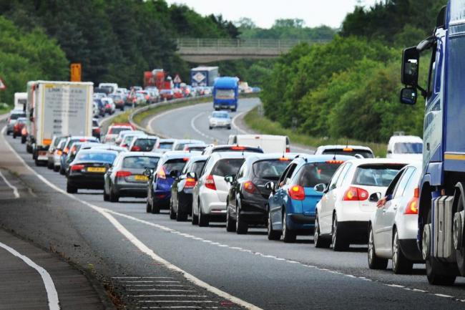
negative impact that poor transport options have on productivity levels & job opportunities
Q. Excluding the global pandemic, what for you is the most important issue affecting your local community?
“Transport is useless from west Oxford. Sitting every morning on the A40 for 45 mins to travel 10 miles is a waste.”
“Traffic, bus routes take longer to get to work (mini plant / JR hospital) than driving and aren't cheap.”
“Wasted time spent queuing in traffic and not being productive.”
“Easy transport to Oxford, would open up jobs and opportunities training at Brooks Uni, Apprenticeships for our young people and would also widen everyone's career aspirations.”
“Transport is a growing issue, more and more people are struggling to get to Oxford where most of the employers are based.”
“The large volume of traffic on the A40; often it takes over an hour to travel by car into Oxford from Eynsham.”
“I travel to London daily, it [new rail route] would make a huge difference to me.”
Image source: Witney Gazette
Notes:
Universal support from those not working but looking for work, disabled and under 17 year olds and those who do not identify as either female or male (all groups very small samples) but interesting all the same.

Slide 13
better transport links will help communities stay connected & provide access to key services
Q. Excluding the global pandemic, what for you is the most important issue affecting your local community?
“Being so close to Oxford but Isolated with lack of transport and local shop.”
“Lack of regular and low cost public transport links throughout the area.”
“Links to other towns, e.g. safe cycle link from Carterton to Witney and an alternative to car travel to Oxford that is reliable and quick.”
“Improve transport links to Oxford hospitals.”
“Roads, public transport, getting kids to school from villages, infrastructure before new building.”
“Isolation from Oxford City centre and access to London made equally difficult.”
“Lack of fast transport links to Oxford and London.”
“Traffic going through Witney to the west because there is no Cogges Link road or equivalent.”
“Public transport and times for commuting especially for me who is visually impaired and rely on public transport.”
“Lack of public transport - impossible to get out of the village without a car (not relevant while we're all in lockdown but it is bad the rest of the time!) - and this also leads to the village being used as a "rat run" for people trying to get around traffic problems on the A40 and A34, which leads to extra traffic and pollution (not to mention people speeding!!).”
“Well done putting this proposal together - excellent! With no joined up WODC, OCC, central Gov thinking or plans for improved transport east, north and south of all the new west oxon housing, your proposal adds a creditable transport plan that I sincerely hope gets approval. Therefore a rail link to Oxford and ideally branching to Oxford Parkway would be an excellent idea - Witney to Marylebone in 1 hr and 15 min . . . hooray!.”
“Public transport disabled accessibility.”
Notes:
Universal support from those not working but looking for work, disabled and under 17 year olds and those who do not identify as either female or male (all groups very small samples) but interesting all the same.

Slide 14
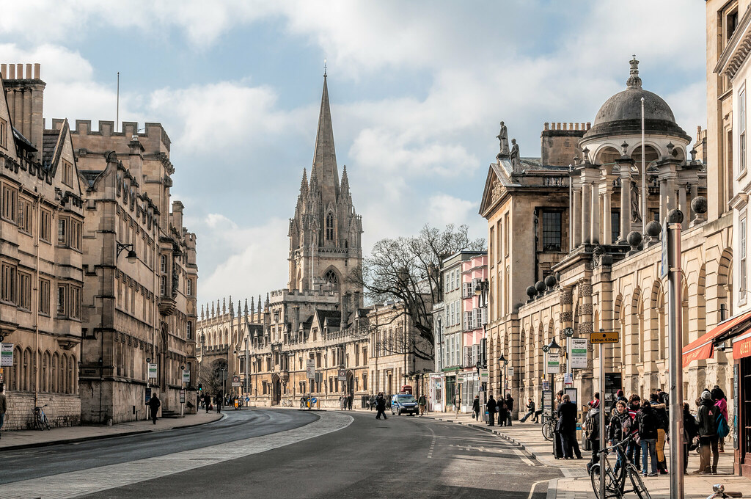
ADVERSE IMPACT POOR TRANSPORT IS HAVING ON OXFORD AS A Destination FOR WORK, RETAIL & ENTERTAINMENT
Q. Excluding the global pandemic, what for you is the most important issue affecting your local community?
“Traffic into Oxford on the A40 makes travel to Oxford totally impossible, for work, for shopping, for recreation. As a family we've taken jobs elsewhere to avoid Oxford, and ruled out recreation trips to Oxford.”
“Public transport to Oxford is shocking making working in Oxford a complete nightmare.”
“Traffic on A40 - cannot shop, work or have leisure in Oxon any more.”
“Commuting in to Oxford on a weekday early morning, it's truly a nightmare.”
“Access to Oxford.”
“Transportation into Oxford.”
Notes:
Universal support from those not working but looking for work, disabled and under 17 year olds and those who do not identify as either female or male (all groups very small samples) but interesting all the same.

Slide 15
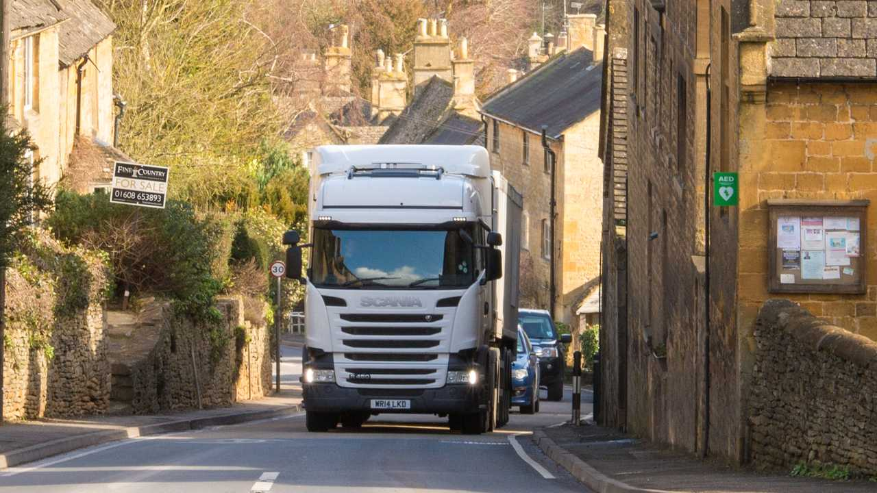
OTHER ISSUES INCLUDe Safety concerns AND transport AFFORDABILITY
Q. Excluding the global pandemic, what for you is the most important issue affecting your local community?
“Larger volumes of traffic traveling at speed, safety of pedestrians.”
“The big increase in commuter traffic through villages.”
“Freight traffic through the villages.”
“Affordable Transport links. Hanborough station is far too expensive compared to Oxford Parkway. This forces drivers to use the A40 and Yarnton cut-through rather than staying within the local area.”
“Local councils being unimaginative and not acting proactively to solve current issues; poor transport links, air pollution, water pollution, road and pavement maintenance/cleanliness and similar. All a bit blinkered in terms of managing and developing (Witney) for the future.”
Image source: https://uk.motor1.com/news/368308/councils-fine-lorries-block-streets/
Notes:
Universal support from those not working but looking for work, disabled and under 17 year olds and those who do not identify as either female or male (all groups very small samples) but interesting all the same.

Slide 16
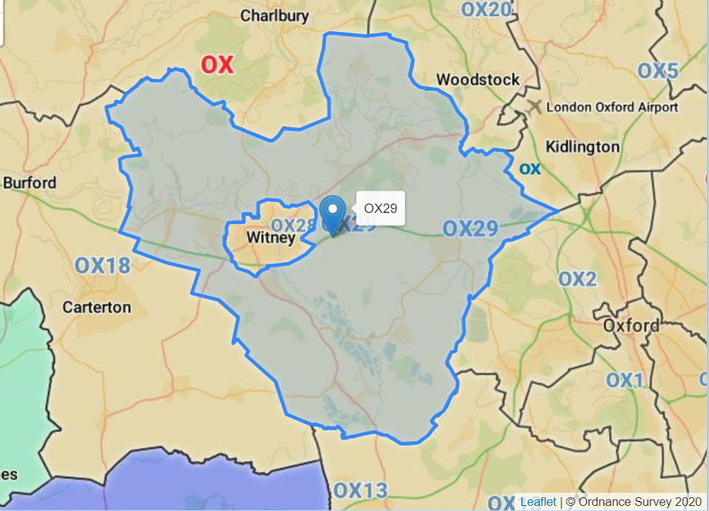
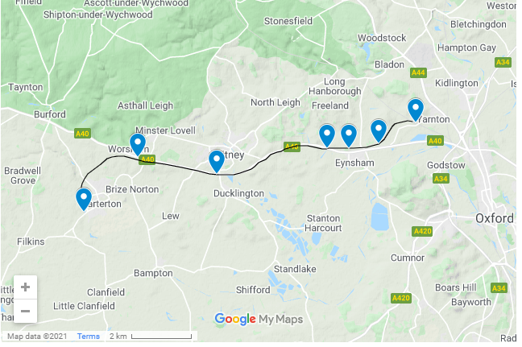
Location of survey participants
There were 515 participants who completed the additional questions and provided location details:
Postcode provided
OX28 postcodes (Witney) | 66
OX29 postcodes (around Witney) | 63
OX18 postcodes (Carterton+) | 52
Other OX postcodes | 36
Location provided instead
Witney | 137
Carterton | 39
Oxford | 26
Eynsham | 26
Bampton | 15
Abingdon | 5
Kidlington | 4
Burford | 4
Woodstock | 3
Cumnor | 3
Stanton Harcourt | 2
Yarnton | 2
Other locations included: Long Hanborough, North Leigh, Ramsden, Finstock, Hailey, Faringdon, Didcot, Charlbury, Brize Norton, Botley | 32
Image source: Streetlist.co.uk
Notes:
Universal support from those not working but looking for work, disabled and under 17 year olds and those who do not identify as either female or male (all groups very small samples) but interesting all the same.

Slide 17
FOR MORE INFORMATION
Charlie Maynard
Chair, Witney Oxford Transport Group
E: cmaynard@witneyoxfordtransport.org.uk
W: www.witneyoxfordtransport.org.uk

